Slide 1


Motivation
Goals
  Foster a sense of community among staff and non-tenure line faculty working in core facilities.
  Promote collaboration and cooperation between core facilities.​
  Educate and enable career advancement for core facility staff and non-tenure line faculty through quarterly meetings.
Our target audience is anyone who performs and/or supports any of these things:
Process samples
Operate and maintain instrumentation
Train students
Consult with users on their projects
Interact with multiple departments on campus
Interact with users external to Penn State

Slide 2
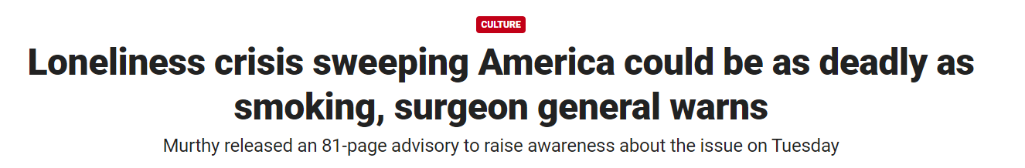
Motivation
Scientific/professional isolation has the same effect on careers hence collaboration grants.
There is a good chance there is something making your job harder that someone else has already figured out.
Hope to foster a community that is positive and solution-oriented.

Slide 3

Motivation
How to foster cooperation between core facilities?
Not a problem unique to Penn State.
The pandemic changed a lot about how we operate.
  Can we leverage some of the technologies we learned during the pandemic?
The ABRF is a national society for core facilities in Biological sciences.
Association of Biomedical Resource Facilities

Slide 4
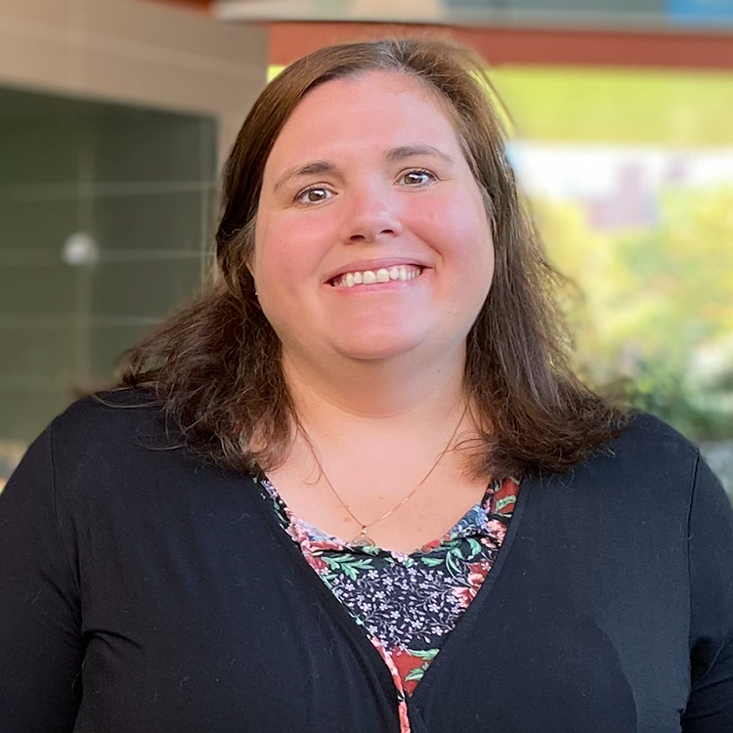

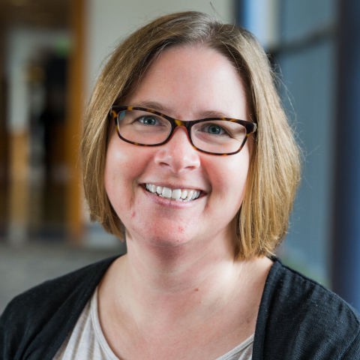
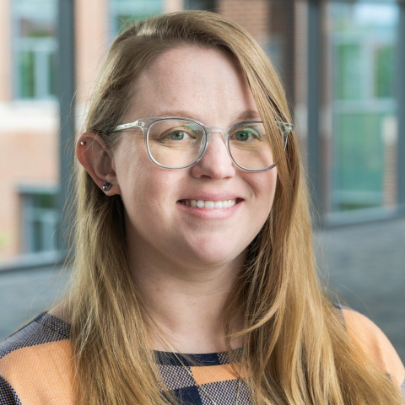
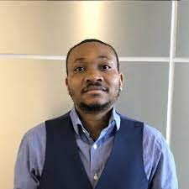
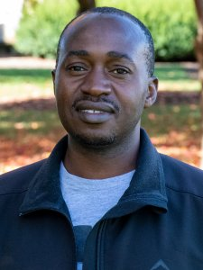
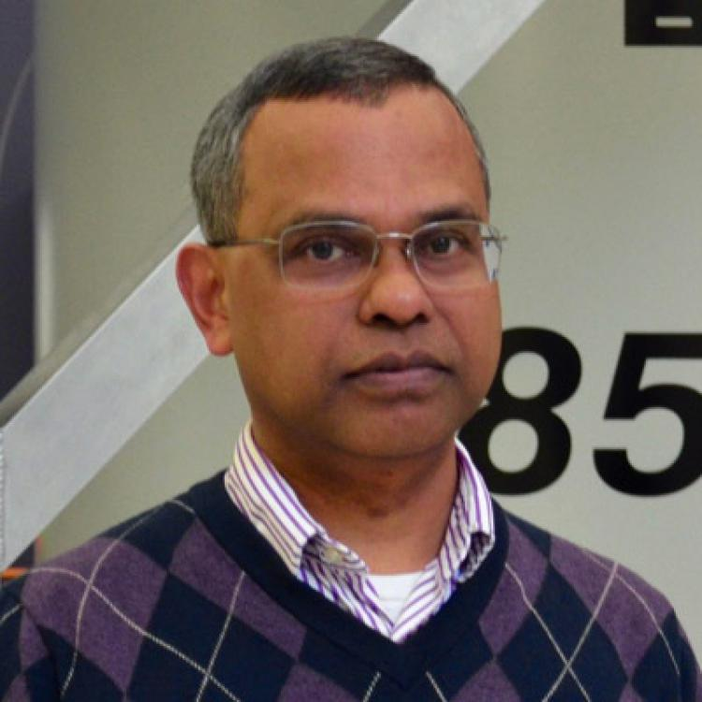
Leadership
Sarah Kiemle (MRI)
Lizz Wagner (Entomology)
Ashley Price (Huck)
Ashley Shay ( Huck)
T.J Zimudzi( MRI)
Hlengilizwe Nyoni( IEE)
Tapas Mal ( Chemistry)
Past committee
members

Slide 5
Membership
Our events have been attended by staff and faculty from several core facilities.
Laboratory for Isotopes and Metals in the Environment (LIME)
Nanofabrication Lab (NanoFab)
Institute of Energy and the Environment (IEE)
Material Characterization Lab (MCL)
2D Crystal Consortium - Materials Innovation Platform (2DCC-MIP)
Chemistry Nuclear Magnetic Resonance facility
Agricultural services lab
IEE Environmental contaminants analytical laboratory
Hershey Medical School core facilities.
Huck Institute core facilities

Slide 6
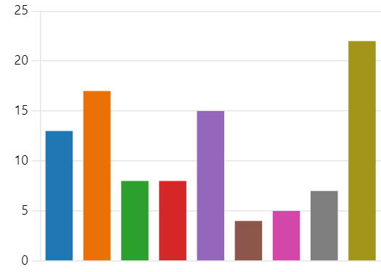
CFC focus areas
Results of poll on the types of things staff and faculty would like the CFC to focus on:
Promotion for core facilities non-tenure line faculty and full-time staff.
Publication and acknowledgment policy.
Core facility recognition (are there any awards for core facility staff?)
User training
Visibility of core facilities (how do people find us)
Purchasing, billing, and ARSO contracts.
Leo vs iLab vs Other
Keeping core facility instruments and staff up to date with modern times.
How to foster cooperation between core facilities.
Coffee and teams
Authorship and acknowledgement working group
We try to organize Coffee and Teams meetings centered around the themes in this poll.

Slide 7
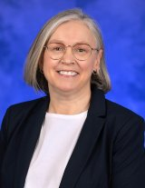
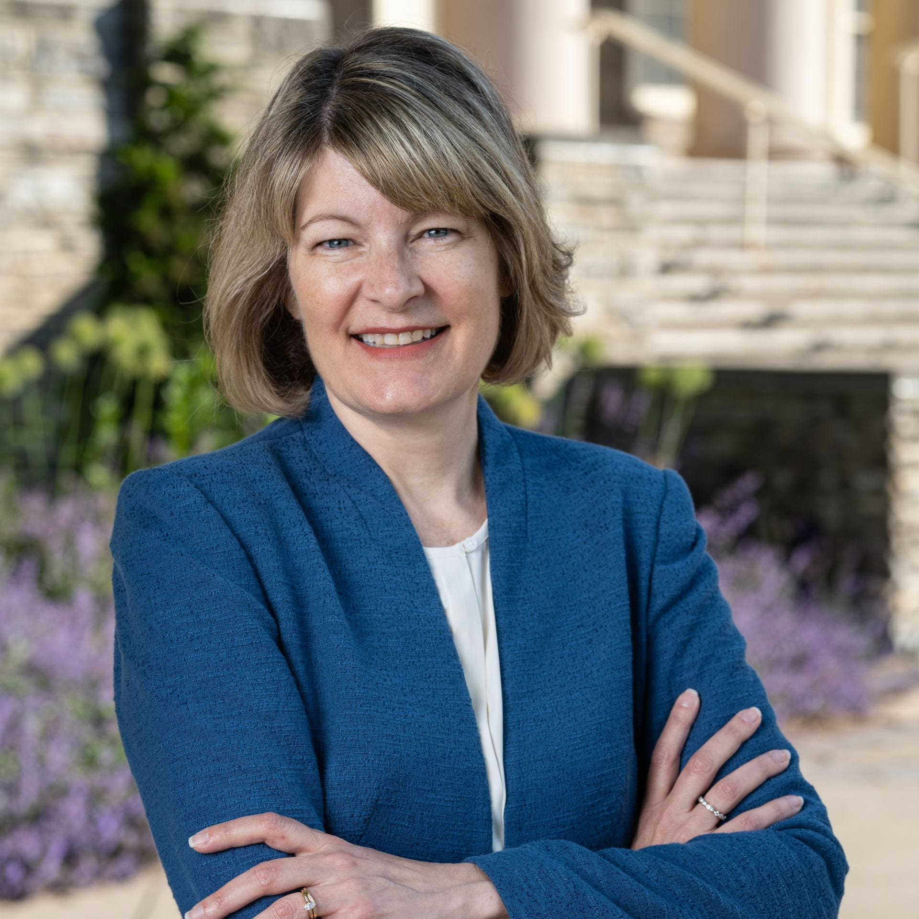
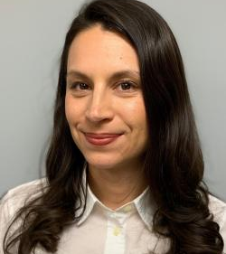
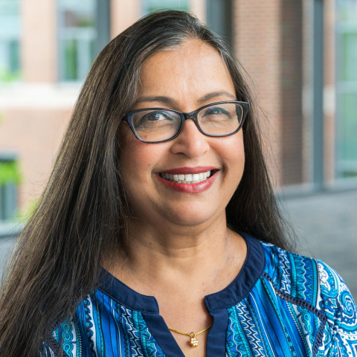
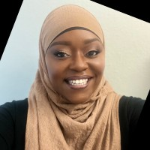
Highlight of Coffee and Teams Talks
9-5-2023
5-1-2024
6-26-2024
6-26-2024
7-31-2024
Maria Bewly
Neela Yennawar
Abby Diehl
Leah Carraway-Justice
Courtney Karmelita
Senior Scientific Director, Core Facilities, Penn State College of Medicine
Director, X-Ray Crystallography and Automated Biological Calorimetry Core Facilities
Associate Vice Provost for Faculty Affairs
Office of Enterprise Change & Transformation
Penn State Office of the President
USAC outreach and engagement co-chair.
Chief of Staff, The Office for Research Protections; Executive Director, Ethical Research and Outreach; Research Integrity Officer
“Hershey medical school core facilities:
Managing research instrumentation and tracking impact”
“Strategic planning for core facility success”
“Non-Tenure-Line Faculty: Support and Resources”
“University staff advisory counsel: what we do and how to be involved”
“Research integrity: authorship acknowledgment and data management”

Slide 8
Coffee and Teams Talks
Tuesday, September 5th 2023 MSC Commons (Kick off)
Sung Hyun (Joseph) Cho – Cryo-Electron Microscope Core Facility – part of Huck. Study 3D structures of proteins and viruses.
Max Wetherington – Material Characterization Lab (MCL)
Maria Bewley – Core Facilities Director at the College of Medicine.
Wednesday, May 1st
Jenn Grey-My experience while working at a core facility for 12 years
Neela Yennawar -Strategic Planning for Core Facility Success
Wednesday, May 29th
Tania Laremore – Director, Proteomics and Mass Spectrometry Core Facility​
Anthony Richardella – from MRI 2D Crystal Consortium
Wednesday, June 26th
Abbey Diehl – Assist Vice Provost of Faculty Affairs – “Non-Tenure-Line Faculty: Support and Resources” Penn State University Staff Advisory Committee
Leah Carraway-Justice – Office of Enterprise Change & Transformation, Penn State Office of the President USAC outreach and engagement co-chair. “University staff advisory counsel: what we do and how to be involved”
Wednesday, July 31st
Courtney Karmelita – Chief of Staff, The Office for Research Protections; Executive Director, Ethical Research and Outreach; Research Integrity Officer “Research integrity: authorship acknowledgment and data management”

Slide 9
Current and Future Activities
2024 (Current)
Contributing to acknowledgment and authorship working group.
  We asked for input and got members to join the working group.
  We helped the working group get examples of current policy implementation.
  Plan to help ORP educate the community of new guidance and hold focus groups and/or gather feedback from core facility community
Plan of campus social for Feb 2025
  Aimed to build a sense of community outside of the work environment
2025 (Planned)
Core tours
  Rotating tours of each core facility, allowing anyone interested to see what each core facility does.
Coffee and Teams (continue summer series April-Aug)
  Talks may include:
    ARSO Process, contracts, purchasing, iLab vs LEO
    Authorship and acknowledgment guidance update
    Opportunities for staff development and recognition of exceptional core facility staff and faculty
Off-campus Social (Winter 2025)

